Slide 1
From Payment Plans to Penalties: Fines and Fees in the Criminal Justice System
Ebony L. Ruhland, PhD | Rutgers University Newark
April 2025
Notes:
LaToya starts with ‘Thank you’s for attending / brief intro

Slide 2
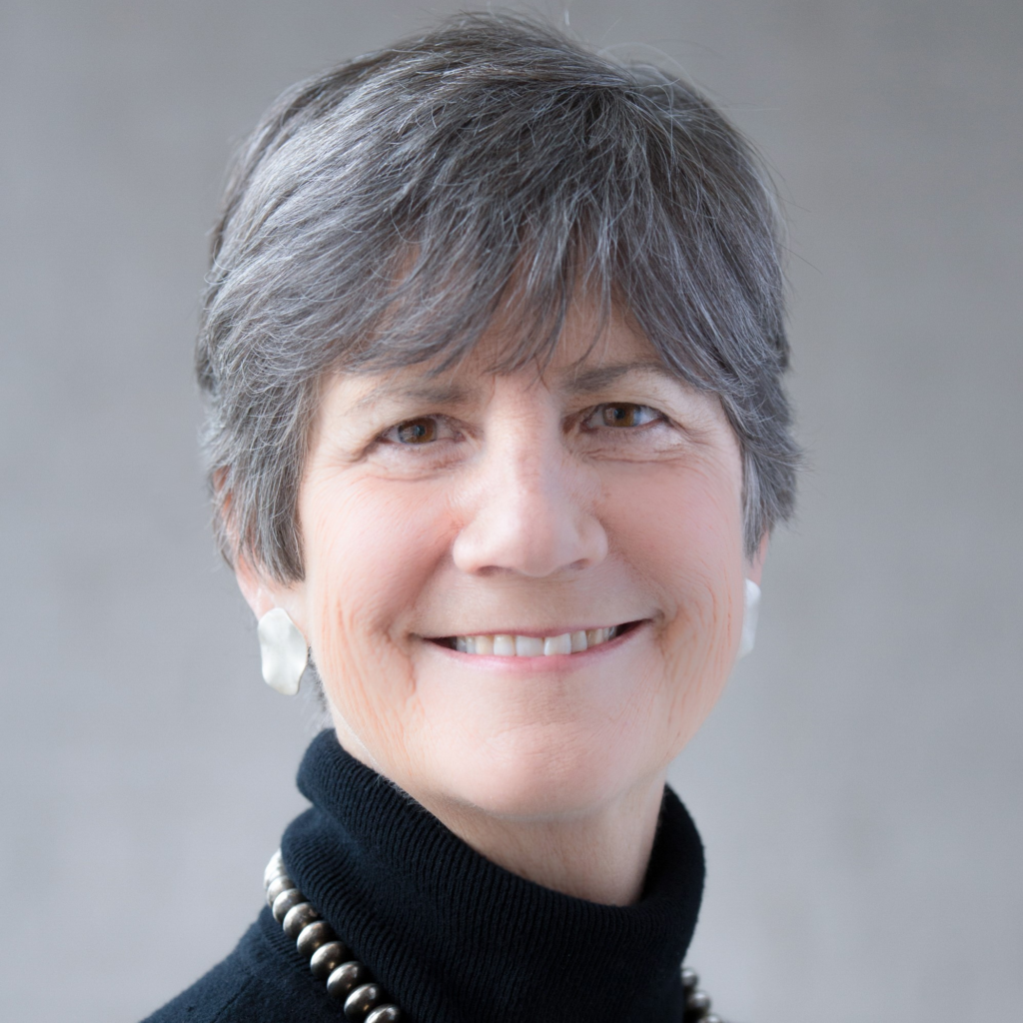
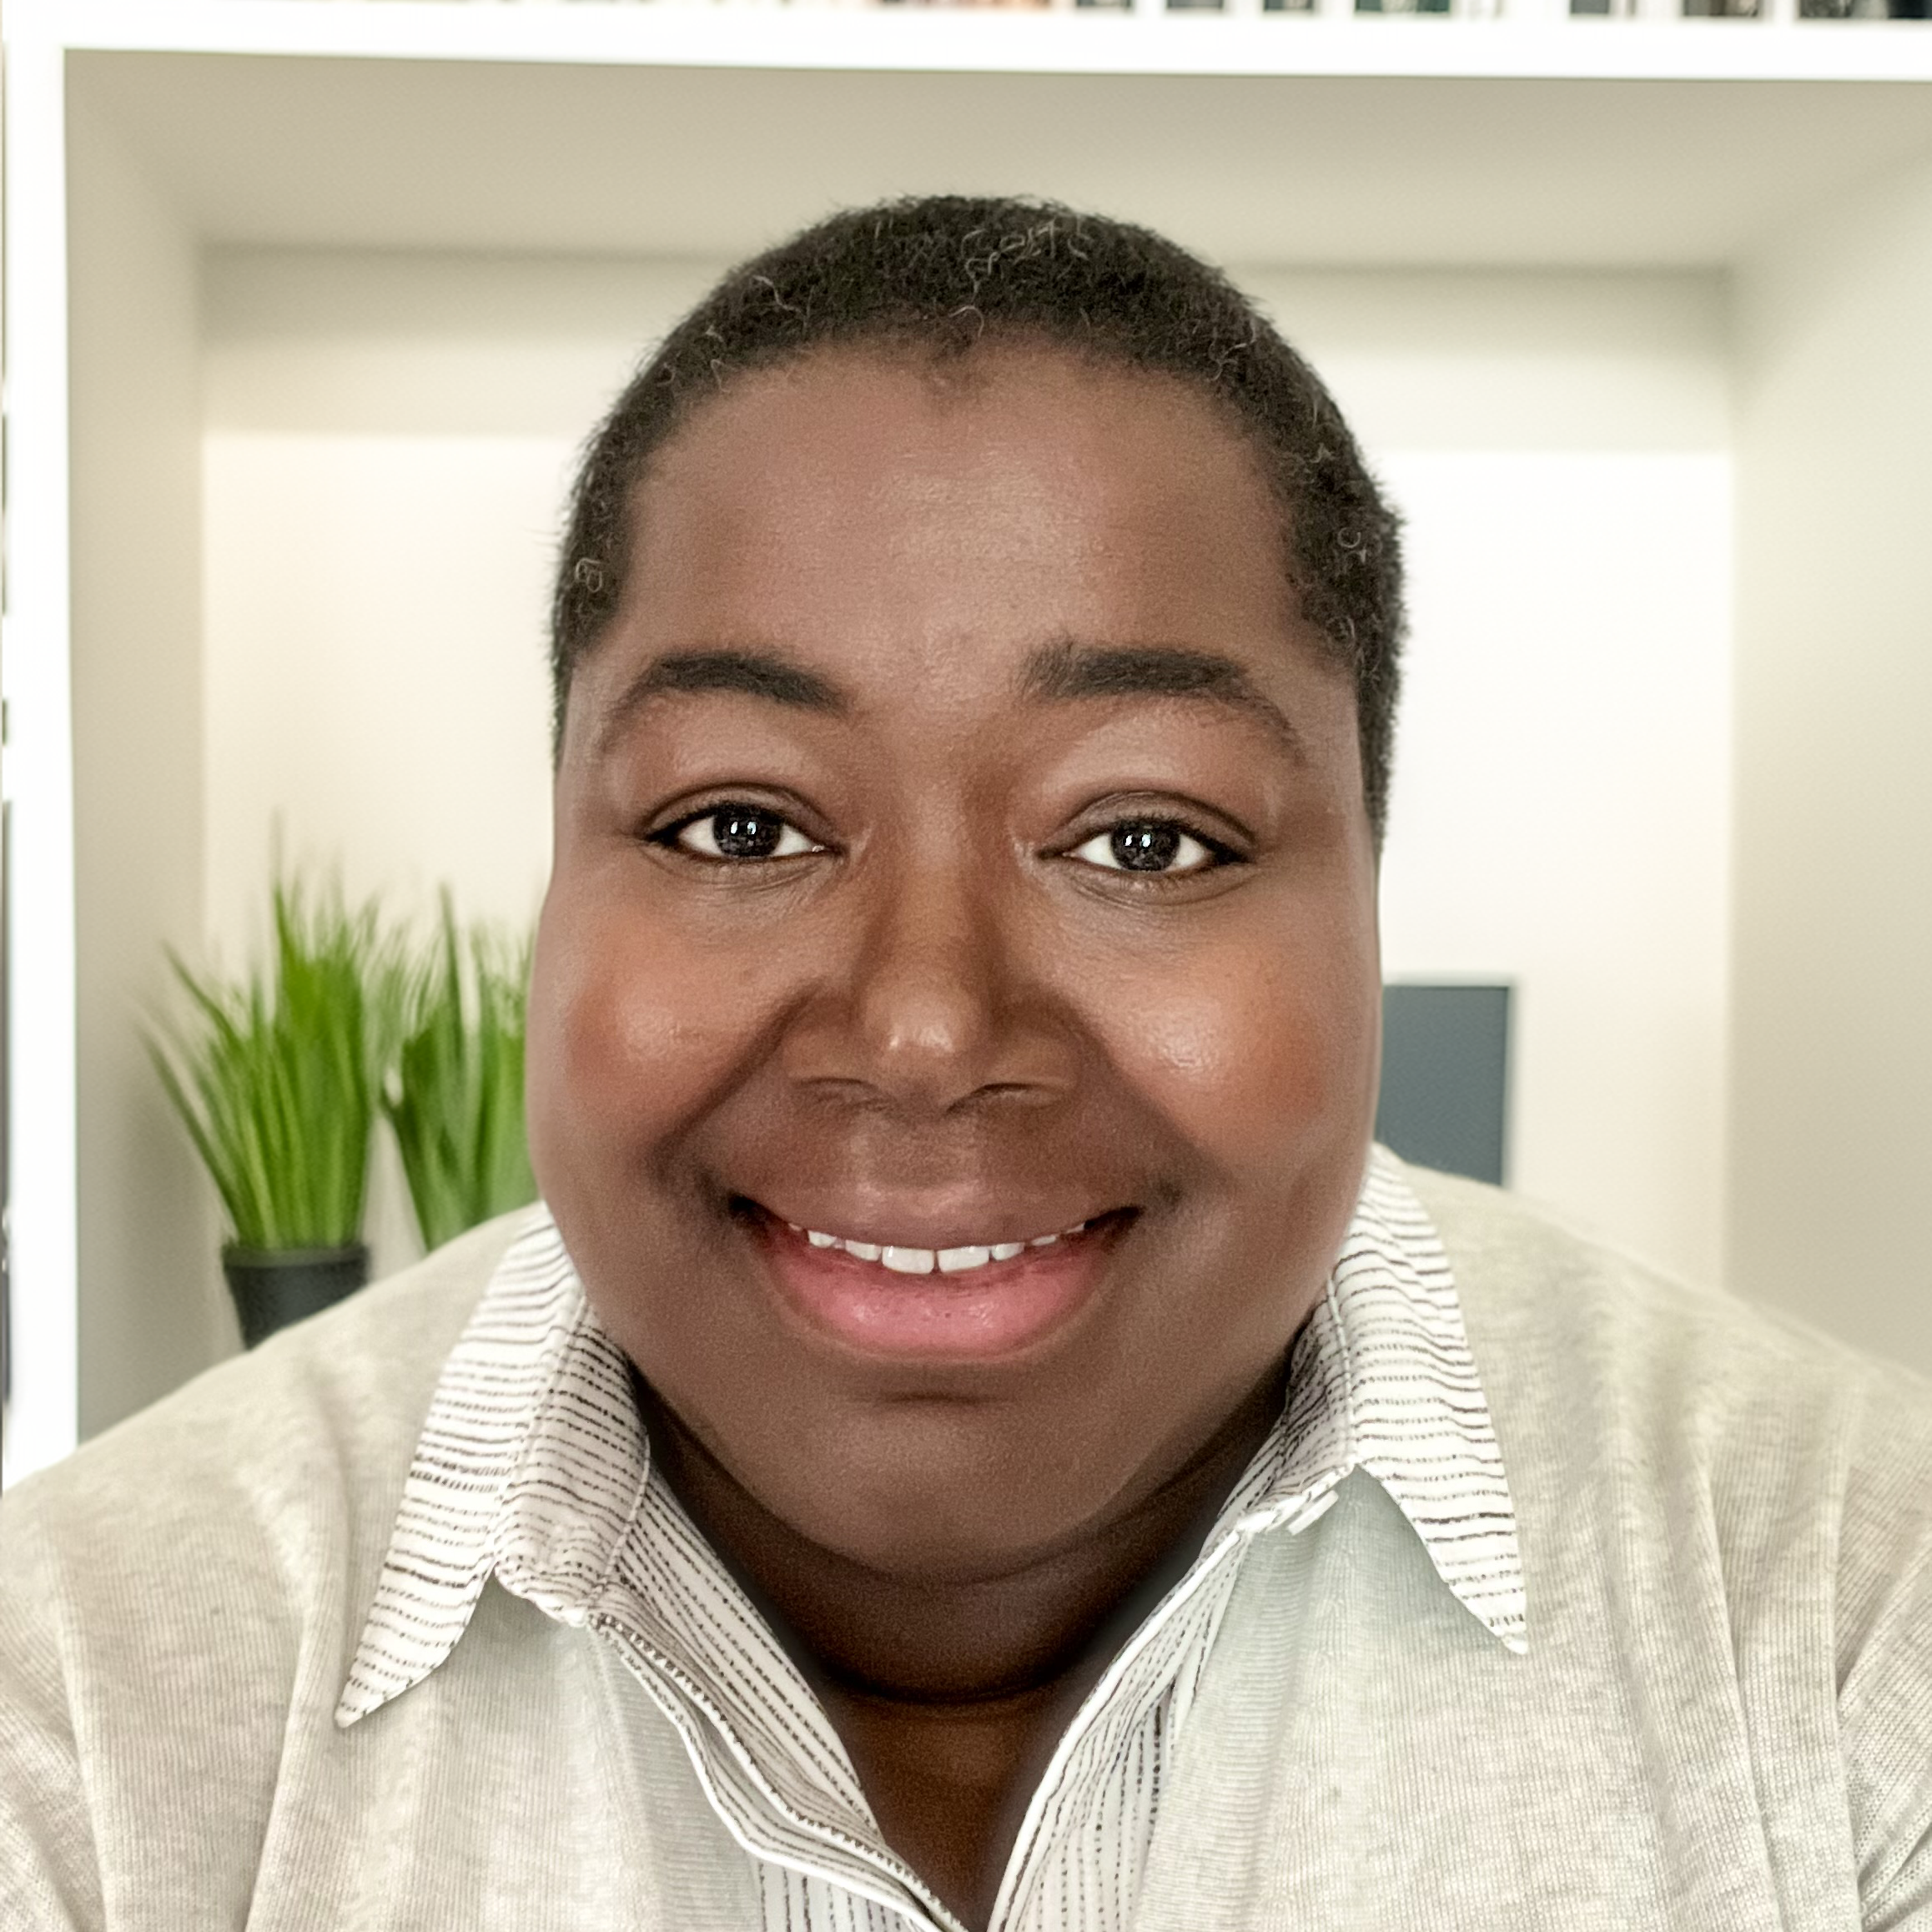
Meet the Presenters
Ebony Ruhland
Andie Moss
LaToya Wesley-Colm
Shawn Flower
Associate Professor
&
Presenter
MJP Founder
&
Moderator
MJP Executive Director
&
Moderator
Choice Research Associates
&
PI The Anat Project
Notes:
Andie will kick it off as the founder
Ebony, Andie, LaToya, and Shawn to briefly self introduce

Slide 3
About Moss Justice Partners (MJP)
Vision: Create safe, supportive, and innovative spaces and services that uplift underserved and marginalized populations.
Mission: Identify and fill critical gaps for justice-impacted individuals and their loved ones through partnerships and innovative solutions.
Notes:
Andie – overall Why of MJP, what her vision is, and then mission

Slide 4
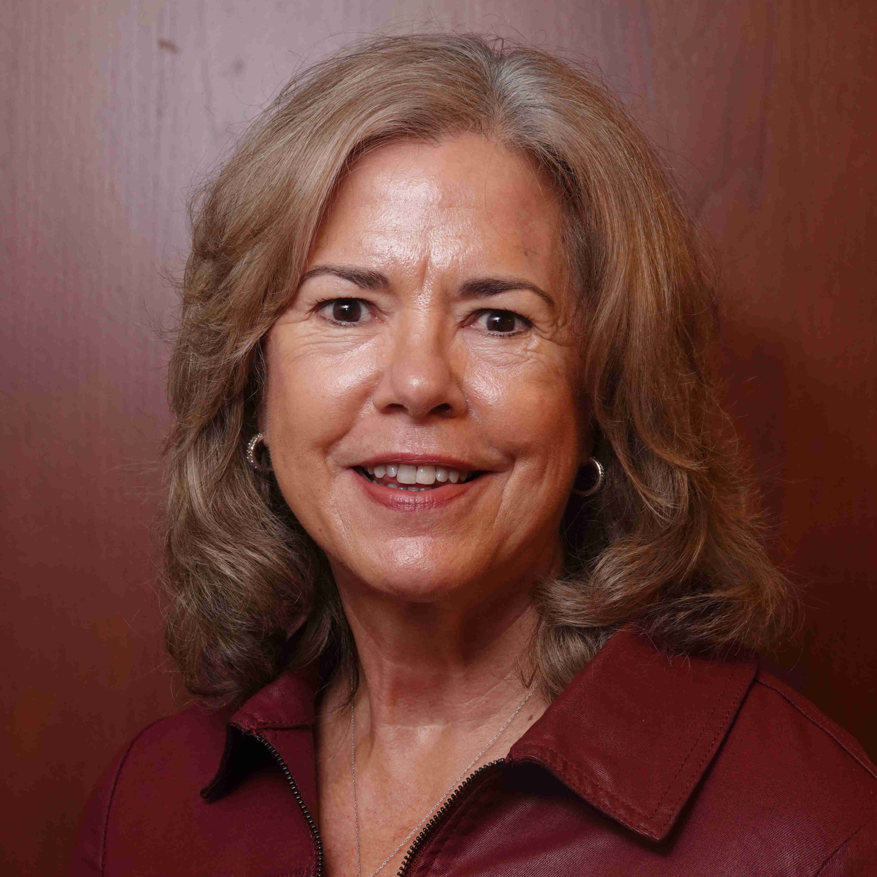
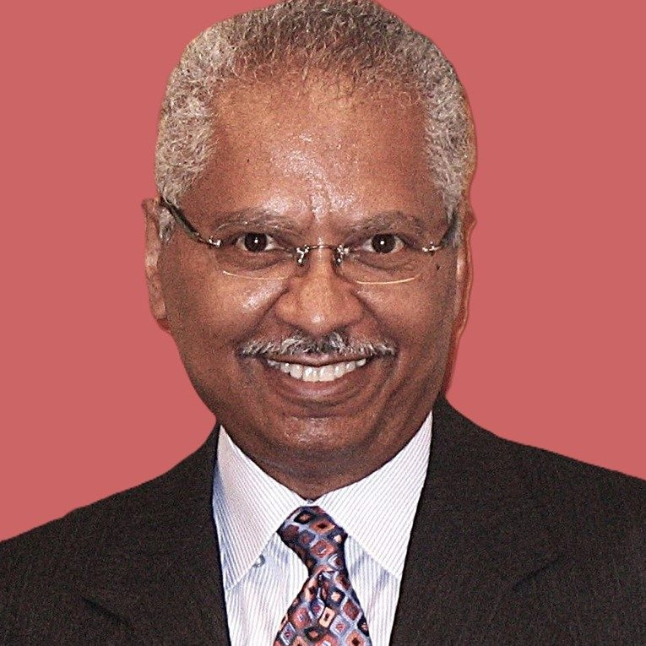
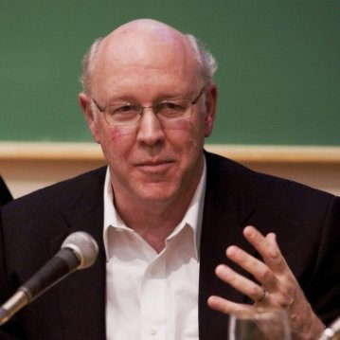
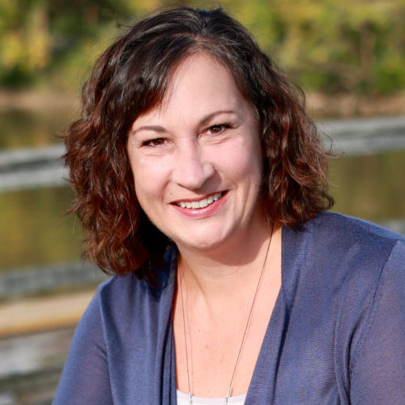
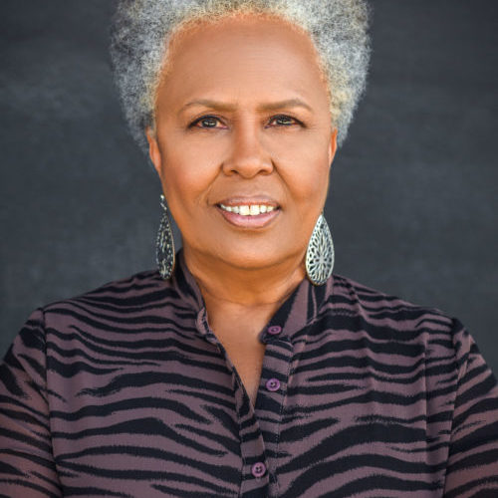
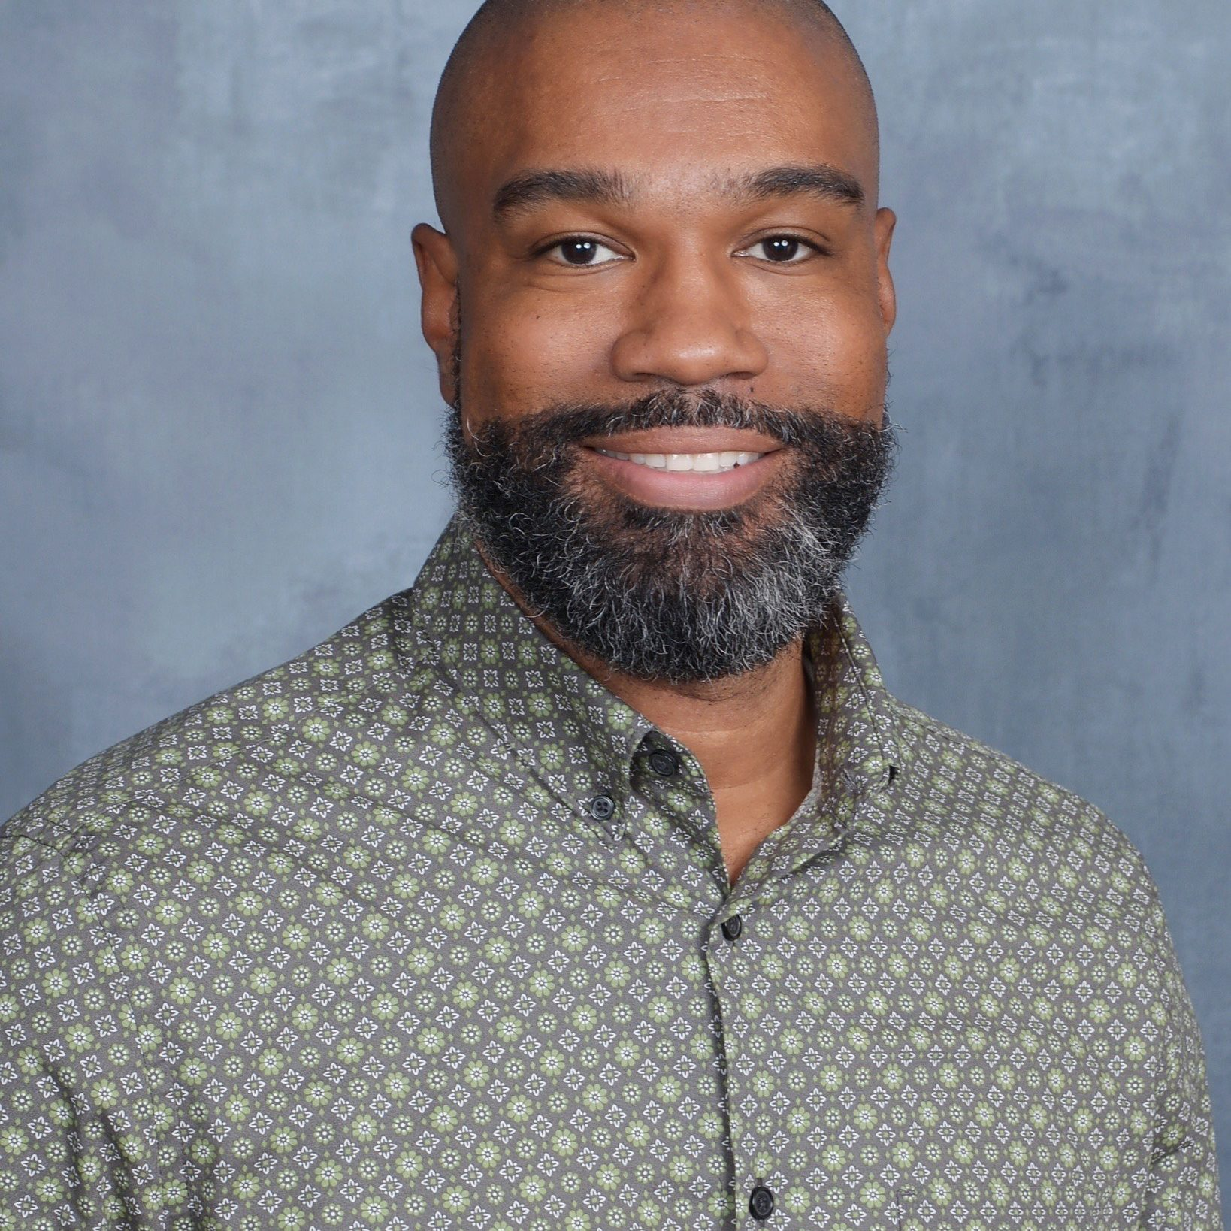
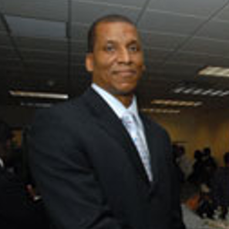
MJP Board of Directors
Ann Schlarb
Reggie Wilkinson
Sam Moss
Karen Wilson
Patrice Gaines
Arthur Chiles
Barbara Ridley
Rodney Mitchell
Notes:
Andie – mention Board’s lived experience, development expertise, etc.
Revise slide to include photos of full Board / Council

Slide 5
MJP’s Key Areas of Focus
Research
Education
Thought Leadership
Reentry & Safety
Scholarships
Notes:
LaToya – talk about the buckets:
Research: Conduct and support research on overlooked areas affecting system-involved populations, leveraging evidence-based practices.
Education: Advocate for and provide training to enhance access to education for underserved communities and justice professionals.
Thought Leadership: Share insights and innovations that can transform the justice system and improve outcomes for those impacted.
Reentry & Safety: Develop programs that support successful reentry and personal and family safety.
Scholarships: Manage funds to support returning students, especially those pursuing careers in finance.

Slide 6
About The Anat Project
The Anat Project seeks to engage with scholars and researchers exploring topics identified as gaps in the criminal justice system and disseminate their findings to judges and other judicial system actors. By sharing evolving evidence-based criminology research data, this will help avoid implicit bias, reduce recidivism, and promote successful reentry.
Notes:
Shawn

Slide 7
Today's Agenda
1
Overview and Background of Monetary Sanctions in the Criminal Legal System
2
Community Corrections Fines and Fees Study
3
Discussion and Next Steps for Research and Policy
Notes:
LaToya/Ebony
Discussion will focus on fairness and effectiveness

Slide 8
Monetary Sanctions
Restitution
Fees*
Fines

Slide 9
Restitution
Restoration
Recovery / Recouping Costs
Individuals and Businesses

Slide 10
Fines
Typically, the punishment for the offense
Varies based on offense type and level

Slide 11
Types of Fees
Court costs
User fees
Community supervision fees
Probation/Parole/Electronic Monitoring)
Program/treatment fees
Administrative fees
Surcharges/interests
Late fees
Special Funds
Notes:
One site I studied at 53 fees individuals could be assessment
Limitations too with program/treatment fees because private providers often providing those

Slide 12
What are the correctional goals of fees?

Slide 13
Background on Monetary Sanctions
Notes:
Discussion will focus on fairness and effectiveness

Slide 14
Background on Monetary Sanctions
The use and number of monetary sanctions has grown (Harris, 2016)
Why?
Rising number of people under correctional control (Phelps, 2018)
Limited increases in operational budgets
Models of “pay your own way” (Ring, 1989)

Slide 15
Background Continued…
Operations of monetary sanctions in community supervision
Vary across the United States but also within states
How the money is used varies:
General funds
Directly by the departments/agencies
Indirect
Other (i.e., roads, victim service funds)

Slide 16
Background Continued…
Some departments heavily rely on them for operations (Jermstad, 2019)
Collections during check-ins and part of the performance review/staff meetings
Reliance on fees → Dependent on people (Jermstad, 2019; King et al., 2022)
Raising concerns over conflicts of interests & potential predatory practices
Restitution not necessarily prioritized
1. Probation supervision fees
2. Restitution
Thus, also creating potentially adverse effects for victims

Slide 17
Background Continued…
Adverse effects of monetary sanctions for individuals ordered to pay them:
Limited employment/income to pay financial obligations (Harris, Evans, & Beckett, 2010)
Balancing other household/family obligations (Harris, 2016; Ruhland, 2021)
Acute and chronic stress due to monetary sanctions (Harris & Smith, 2022)

Slide 18
Background Continued…
Impacts on supervision outcomes:
Individuals with lower fee collection rates, more likely to have their probation revoked (Olson & Ramker, 2001)
Individuals assessed higher amounts of fees, significantly more likely to be revoked (for either TV or new offense) (Ruhland, Holmes, & Petkus, 2020)
Greater delinquency in debt, greater odds of being revoked
Yet, one study showed monetary sanctions did not influence probation violations (Iratzoqui & Metcalfe, 2017)
Notes:
Iratzoqui A., Metcalfe

Slide 19
Monetary Sanctions in Community Supervision
Several conditions individuals on supervision must follow or face consequences
Monetary sanctions commonly ordered as conditions of their supervision
Thus, can receive consequences for nonpayment
Bearden vs. Georgia
Willful nonpayment or misplace priorities?

Slide 20
Potential Consequences for Late or Nonpayment
Additional Sanctions
Wage
Garnishment
Tax Collections
Civil Collections
Revocation
Bearden v. GA

Slide 21
Community Corrections Fines and Fees Project (CCFF)
Generously Supported By Arnold Ventures

Slide 22
CCFF TEAM

Slide 23
Other Acknowledgements
Alexes Harris
University of Cincinnati
Individuals on probation and parole
Correctional and court agencies
Notes:
Iratzoqui A., Metcalfe

Slide 24
CCFF Project Goals
Systemically analyzed how fines and fees operate in community corrections
Explored the consequences of fines and fees, and related factors, on supervision success and on other areas of the individual’s lives
Notes:
Iratzoqui A., Metcalfe

Slide 25
CCFF Methods
Quantitative:
Court & probation administrative data
Online survey with probation and parole officers/directors
Budget reviews
Policy review
Statutes
Department policies
Qualitative:
Interviews with individuals on community supervision (probation/parole)
Interviews with their support person
Notes:
Iratzoqui A., Metcalfe

Slide 26
Administrative
Data Findings

Slide 27
Table 4. Full Sample Monetary Sanction Comparisons
State | IN | MI | PA | TX^{d} | VAª
Total Sample (n) | 990 | 462 | 118,050 | 7418 | 222,265
Total Amount Assessed
% Sample Assessed Fines & Fees | 93% | 100% | 100% | 99% | NA
Mean | $1258.10 | $2099.17 | $ 3,823.62 | $4127.82 | NA
sd | $5131.29 | $2073.30 | $28,234.94 | $4751.02 | NA
Median | $590.00 | $1561.67 | $1977.80 | $3032.56 | NA
Range | $0- $113315.00 | $100-$24567.00 | $0.00- $4,058,983.00 | $337- $64639.13 | NA

Slide 28
Total Fines^{e} | IN | MI | PA | TX^{d} | VAª
% Sample Assessed | 8% | 92% | 37% | 63% | NA
% Total Amount Assessed | 1% | 9% | 21% | 14% | NA
Mean | $3.67 | $145.21 | $642.09 | $438.74 | NA
sd | $22.08 | $128.10 | $1,027.69 | $456.92 | NA
Median | $0 | $100.00 | $300.00 | $375.00 | NA
Range | $0 - $250.00 | $0 - $1,100.00 | $1.00 - $51,000.00 | $0 - $3,500 | NA
Total Restitution
% Sample Assessed | 13% | 18% | 22% | 19% | NA
% Total Amount Assessed | 8% | 7% | 41% | 7% | NA
Mean | $633.36 | $361.30 | $6,915.30 | $781.00 | NA
sd | $5,148.37 | $1,634.09 | $55,018.07 | $3,840.99 | NA
Median | $0 | $0 | $927.50 | $0.00 | NA
Range | $0 - $113,000.00 | $0 - $23,042.00 | $0.99 - $3,246,362.00 | $0 - $69,235.46 | NA
Total Fees
% Sample Assessed | 90% | 100% | 99% | 99% | NA
% Total Amount Assessed | 82% | 88% | 83% | 84% | NA
Mean | $632.04 | $1,728.26 | $2,049.30 | $3,055.56 | NA
sd | $639.95 | $1,544.81 | $3,472.31 | $2,370.36 | NA
Median | $529.17 | $1,385.50 | $1,593.50 | $2,394.83 | NA
Range | $0 - $8,576.50 | $100 - $13,693.00 | $0.00 - $812,621.10 | $267 - $12,756.95 | NA

Slide 29
Online
Survey Findings

Slide 30
Percentage of Respondents Who Agreed Their Agency Culture Involves Trying to Collect as Many Fees as Possible

Slide 31
Fines and Fees in Community Supervision
Table 15. Ability to Pay Assessments by State
State | No Assessment | Informal Assessment | Formal Assessment
Indiana | 14% | 41% | 45%
Massachusetts | 18% | 27% | 56%
Michigan | 52% | 39% | 9%
Pennsylvania | 49% | 40% | 12%
Texas | 34% | 48% | 18%
Virginia | 43% | 47% | 11%
Notes:
Few formal financial assessments used to determine ability to pay

Slide 32
Fines and Fees in Community Supervision
Factors in Informal Assessment
State | Top 1 | Top 2 | Top 3
Indiana | Employment | Client’s Budget | Cost Of Living
Massachusetts | Employment | Number Of Children | Client’s Budget
Michigan | Employment | Client’s Budget | Number Of Children
Pennsylvania | Employment | Client’s Budget | Mental Health
Texas | Employment | Client’s Budget | Material Possession
Virginia | Employment | Client’s Budget | Other*
*Other may have included receiving public assistance or disability status

Slide 33
Percentage of Respondents Reporting They "Almost Never" or "Never" Request Financial Waivers
Notes:
Few financial waivers
Percentage of Respondents Reporting They "Almost Never" or "Never" Request Financial Waivers

Slide 34
Potential Consequences for Nonpayment
State | Extend Supervision Term | Violate for Nonpayment & Other Conditions | Send Fees to Collections | Send to Civil Judgements
Indiana | 36% | 58% | 46% | 61%
Massachusetts | 54% | 78% | 2% | 0%
Michigan | 62% | 62% | 24% | 29%
Pennsylvania | 34% | 48% | 41% | 17%
Texas | 96% | 35% | 2% | 11%
Virginia | 4% | 3% | 18% | 5%

Slide 35
Qualitative Findings

Slide 36
Qualitative Interview
98 Individuals on Community Supervision
28 Supportive Persons
Notes:
Iratzoqui A., Metcalfe

Slide 37
Challenges
 | Yes | No | Missing | Not Applicable
Difficulty Meeting the Conditions of Supervision | 85 | 13 | 0 | -
Made late payments (or nonpayment) for required monetary sanctions | 52 | 41 | 5 | -
Fear or concern of violation or incarceration due to nonpayment | 56 | 14 | 28 | -
Concern or possibility of extension of supervision due to nonpayment | 24 | 8 | 66 | -
Impact on Family/Support System | 60 | 25 | 13 | -
Struggles to find/maintain employment | 52 | 25 | 17 | 4
Unable or struggle to pay needs | 60 | 25 | 13 | -

Slide 38
Challenges – Meeting the Conditions
Difficulty with conditions:
I have to go to outpatient four days a week. They want you to do meetings. They want you to do all these things and you're so stressed financially, and then you pile out other things on that often these people back out to doing things that led them first place to back to where they were. It's the expectations and with that I think are just too high.
Notes:
“It really does affect my ability to complete [supervision]. It makes it harder for me to complete because by the time I’ve spent most of my time trying to figure out how to get the money, then the other little bit of spare time I’ve got I have to use it for meetings and classes and things like that.”

Slide 39
Challenges – Pushing Money Around
Pushing monetary sanctions and other bills around:
So, the first month I had to push it around or the first month I paid it. The second month I had to push it around and then I just honestly stopped paying it.
We scrape together pennies just to go buy toilet paper, you know,…and we both work full-time…we both work forty hours a week…it’s a lot, it’s a lot. It takes a lot.

Slide 40
Challenges – Finding Money
When asked what are way individuals on supervision find money to pay monetary sanctions, responses included:
Donating plasma
Pawning furniture
Borrowing friends or family
“Hustlin”
Doing odd jobs
Selling drugs (Small number but still important nonetheless)

Slide 41
Challenges - Threats
Threats of sanctions
Well, they threaten all the things that they can extend your parole if you don't pay your fees, that you can be violated because it’s a condition of your parole. Those were the two main threats right there. Extension of parole or revocation.
Worries of incarceration
It made me feel worried like, if I don’t pay it I’m gonna go back to jail.

Slide 42
Discussion

Slide 43
Key Findings
Individuals are assessed large amounts of fees (fines and restitution)
Few states (in this study) used formal assessments to determine ability to pay or financial waivers
The stress of payments significantly affects their experiences on community supervision
As well as there personal and family relationships

Slide 44
Fairness & Effectiveness of Monetary Sanctions
Predatory practices because of the reliance
Consequences for nonpayment (threats of revocation)
Additional burdens to come up with the money
Collections and enforcement takes away from other correctional goals
Notes:
Iratzoqui A., Metcalfe

Slide 45
Future Directions

Slide 46
Recommendations
Policy/Practical
Research
Abolish/eliminate fees
All or at least some
Use ability to pay assessments
Set realistic payment
Do not tie fees to conditions
Identify non-punitive options for late/nonpayment
Evaluate how the money is used/where it is going
Test ability to pay assessments
Conduct experimental designs to measure impacts on success outcomes
Administer cost/benefit studies
Dig deeper in qualitative methods

Slide 47
QUESTIONS?

Slide 48
References
Harris, Al. & Smith, T. (2022). Monetary Sanctions as Chronic and Acute Health Stressors: The Emotional Strain of People Who Owe Court Fines and Fees. RSF: The Russell Sage Foundation Journal of the Social Sciences Jan 2022, 8 (2) 36-56; DOI:10.7758/RSF.2022.8.2.02
Harris A. (2016). A pound of flesh: Monetary sanctions as punishment for the poor. Russell Sage Foundation.
Harris A., Evans A., Beckett B. (2010). Drawing blood from stones: Legal debt and social inequality in the contemporary United States. American Journal of Sociology, 115(6), 1753–1799
Iratzoqui A., Metcalfe C. (2017). Set up for failure? Examining the influence of monetary sanctions on probation success. Criminal Justice Policy Review, 28(4), 370–393.
Jermstad T. (2019). Inherently unstable: The history and future of reliance on court-imposed fees in the state of Texas. Federal Probation, 83(1), 50–61.
Klingele C. (2013). Rethinking the use of community supervision. Journal of Criminal Law & Criminology, 103(4), 1015–1069.
King, K.J.B., Petkus, A., & Ruhland, E.L. (2022). Exploring how fines and fees finance community supervision. Federal Sentencing Reporter, 34(2-3), 139–144.
Olson, D.E. & Ramker, G.F. (2001). Crime does not pay, but criminals may: Factors influencing the imposition and collection of probation fees. The Justice system Journal, 22, 29 – 46.
Phelps M. (2018). Mass probation and inequality: Race, class, and gender disparities in supervision and revocation. In Ulmer J. T., Bradley M. (Eds.), Handbook on punishment decisions: Locations of disparity (Vol. 2, pp. 43–66). Routledge.
Ring, C.R. (1989). Probation supervision fees: Shifting costs to the offender. Federal Probation, 53, 43 – 48.
Ruhland, E.L. (2021). It’s all about the money: An exploration of probation fees. Corrections: Policy, Practice, and Research, 6(1), 65-84.
Ruhland, E., Holmes, B., & Petkus, A. (2020). The Role of Fines and Fees on Probation Outcomes. Criminal Justice and Behavior, 47(10), 1244–1263. https://doi.org/10.1177/0093854820918877
Notes:
Monetary Sanctions as Chronic and Acute Health Stressors: The Emotional Strain of People Who Owe Court Fines and Fees
Alexes Harris, Tyler Smith
RSF: The Russell Sage Foundation Journal of the Social Sciences Jan 2022, 8 (2) 36-56; DOI:10.7758/RSF.2022.8.2.02

Slide 49
Contact Information
Ebony Ruhland, PhD
Andie Moss
LaToya Wesley-Colm, PhD
Shawn Flower, PhD
Ebony.Ruhland@Rutgers.edu
amoss@mossgroup.us
lwesleycolm@mossjustice.org
shawn@choiceresearchassoc.com
mossjustice.org

Slide 50
THANK YOU!

